Slide 1
PARAMETRIC EQUALIZER
Marin Cătălin
Matei Daniel
Nechifor Silviu-Mihail
Group 441G

Slide 2
01
Introduction
Abstract of the application
05
Conclusions
Improvements and future applications
02
Audio Processing
06
Gannt chart
Reading & playing the audio
Contributions to the project
03
Filter implementations
07
Bibliography
Comparisons between filter implementations
Improvements and future applications
04
Graphical User Interface(GUI)
State machine & knobs utility
CONTENTS

Slide 3
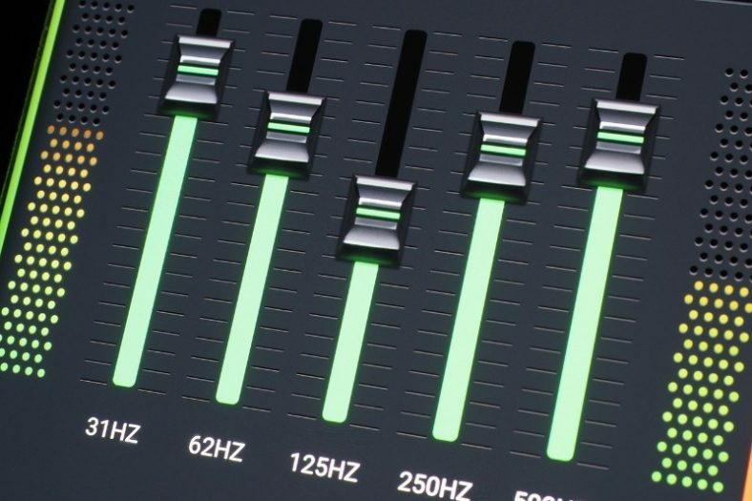
Introduction
Advanced Equalizer Design with DSP Principles implemented in MATLAB
Flexible Control and Precision in Audio Manipulation
User Experience through Intuitive GUI

Slide 4
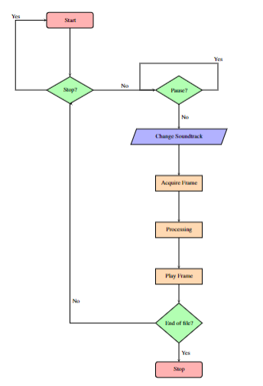
Flowchart
Nechifor Silviu

Slide 5
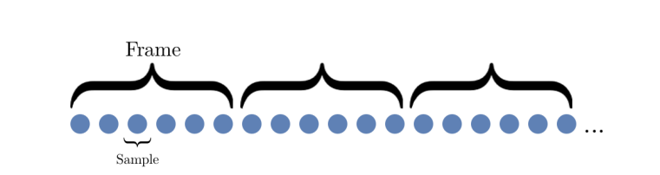
Audio Processing
1. Real time audio replay

Slide 6
Audio Processing
Example of real time audio replay(from Matlab documentation):
afr = dsp.AudioFileReader('speech_dft.mp3','ReadRange’, [1 3*22050]);
adw = audioDeviceWriter('SampleRate', afr.SampleRate);
while ~isDone(afr)
audio = afr(); adw(audio);
end
release(afr);
release(adw);

Slide 7
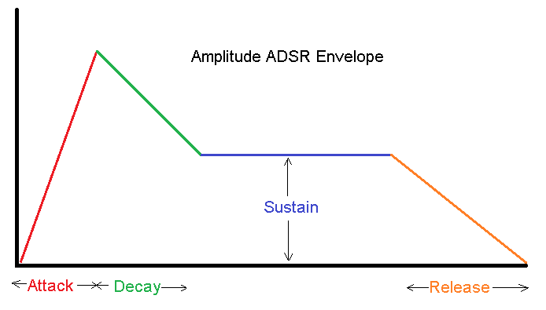
Audio Processing
ADSR window

Slide 8
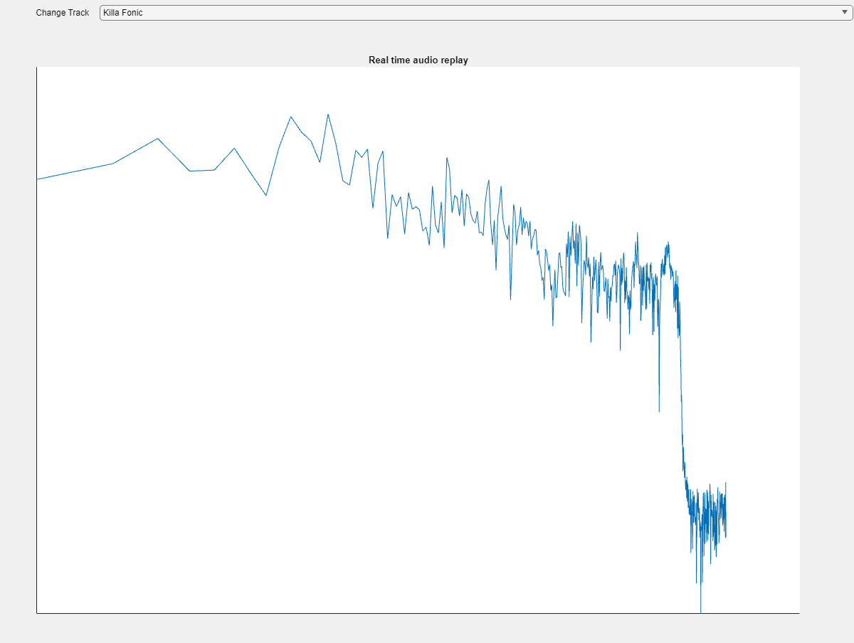
Audio Processing
Plotting the frequency context in real time using fft()

Slide 9
Flowchart
Catalin Marin

Slide 10
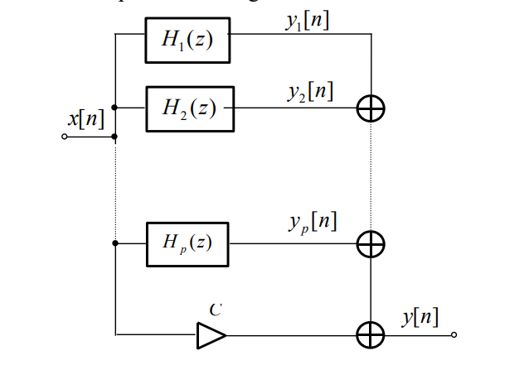
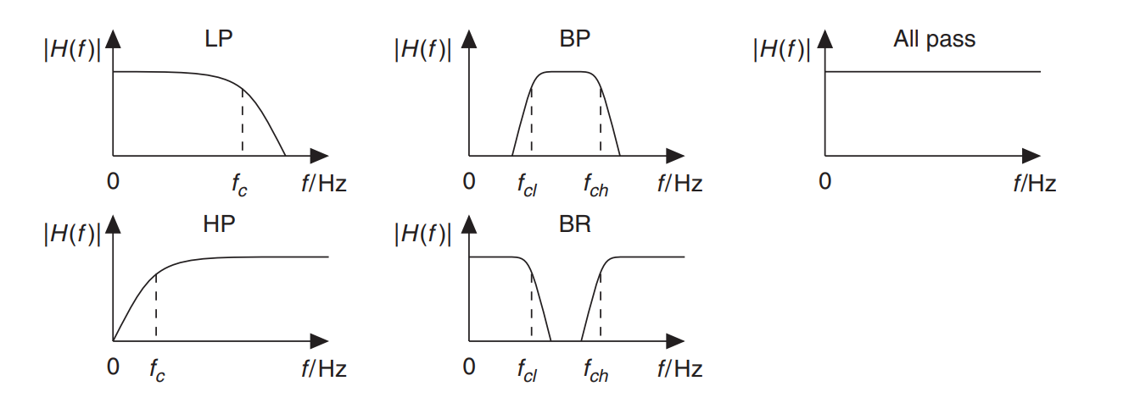
Filter Implementations

Slide 11
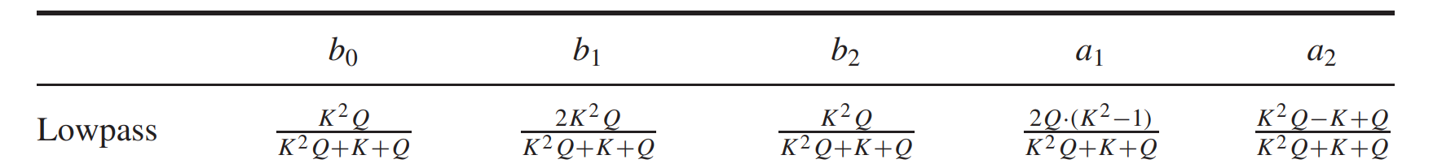
case 2 % LPF
f0 = 500;
K = tan(pi*f0/fs);
Q = 1/sqrt(2);
b0 = K^2*Q/(K^2*Q+K+Q);
b1 = 2*K^2*Q/(K^2*Q+K+Q);
b2 = K^2*Q/(K^2*Q+K+Q);
a0 = 1;
a1 = 2*Q*(K^2-1)/(K^2*Q+K+Q);
a2 = (K^2*Q-K+Q)/(K^2*Q+K+Q);
b = [ b0 b1 b2 ];
a = [ a0 a1 a2 ];
y = filter(b,a,x);

Slide 12
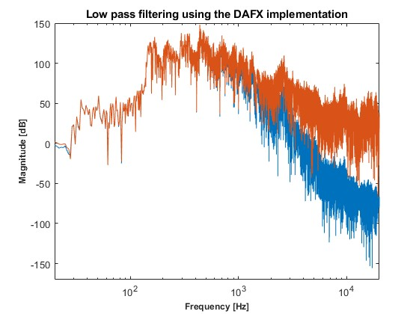

Filter Implementations

Slide 13
Flowchart
Matei Daniel

Slide 14
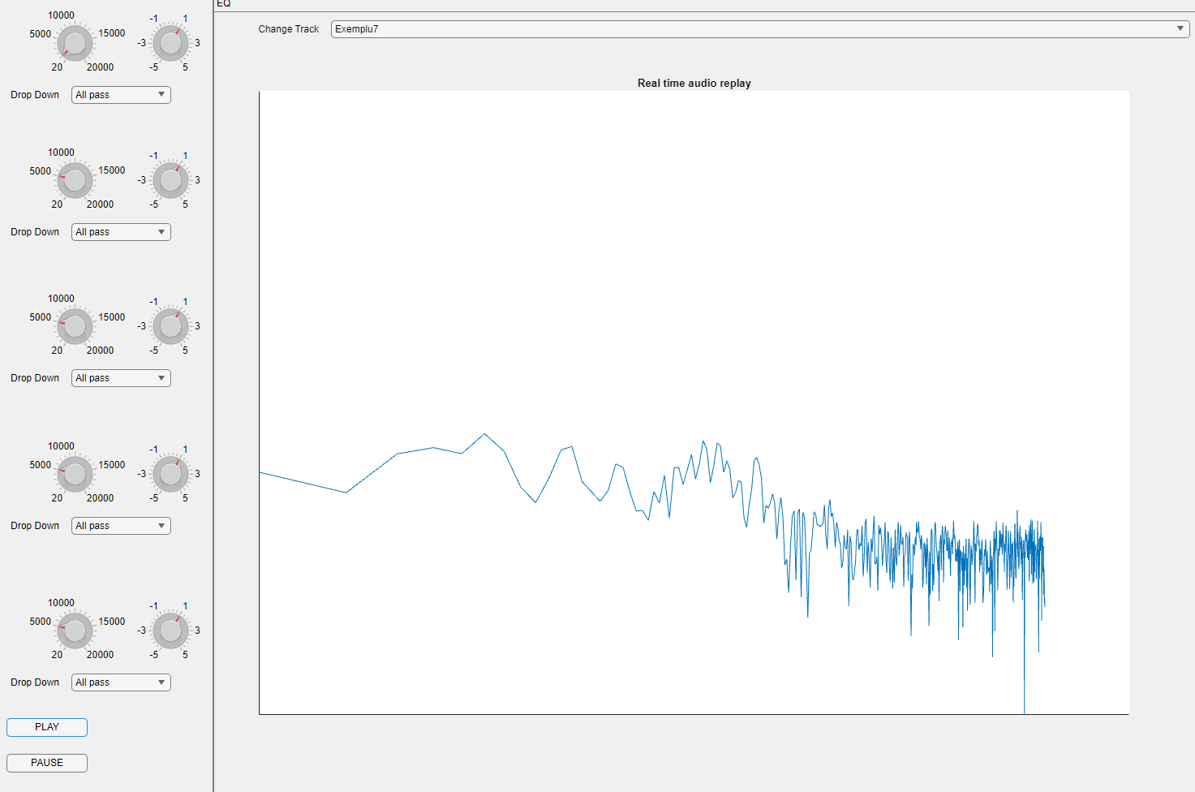
Graphical User Interface (GUI)

Slide 15
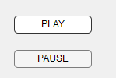
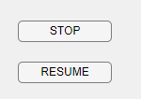
Graphical User Interface (GUI)
% Button pushed function: PLAYButton
function PLAYButtonPushed(app, event)
if strcmp(app.PLAYButton.Text,'PLAY')
app.pushed = 1;
app.PLAYButton.Text = "STOP";
updateGraph(app,1);
elseif strcmp(app.PLAYButton.Text,'STOP')
app.actuallyStopped = 1;
updateGraph(app,1);
app.PLAYButton.Text = 'PLAY';
end
end
function PAUSEButtonPushed(app, event)
app.stopped =1;
if strcmp(app.PAUSEButton.Text,'RESUME’)
app.PAUSEButton.Text = 'PAUSE';
else
app.PAUSEButton.Text = 'RESUME';
end updateGraph(app);
startupFcn(app);
cla(app.UIAxes);
end

Slide 16
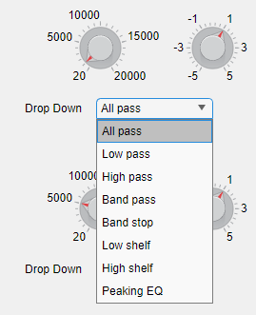
Graphical User Interface (GUI)
% Value changing function: f1
function f1ValueChanging(app, event)
app.freq1 = event.Value;
updateGraph(app);
end
% Value changed function: filter1
function filter1ValueChanged(app, event)
app.filtertype(1,:) = killafonic(app.filter1.Value);
updateGraph(app);
end

Slide 17
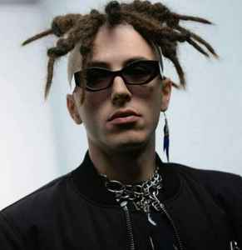
Graphical User Interface (GUI)
Easter egg debunking
function short = killafonic(long)
if strcmp(long(1, :), 'All pass')
short = 'APF';
elseif strcmp(long(1, :), 'Low pass')
short = 'LPF';
elseif strcmp(long(1, :), 'High pass')
short = 'HPF';
...
...
% the same for the rest of the filters
end

Slide 18
Bibliography
[1] Udo Zolzer, ”DAFX - Digital Audio Effects”, in ”John Wiley and Sons”, 2002 ¨
[2] Robert Bristow-Johnson, ”Audio EQ Cookbook”, in ”W3C Working Group Note”, 2021
[3] Royer, Theo, ”Pitch-Shifting Algorithm Design and Applications in Music” Stockholm, Sweden, 2019 ´
[4] P. P. Rayan Kutty and A. Sreenivasa Murthy, ”Kalman filter using quantile based noise estimation for audio restoration,”2011 International Conference on Emerging Trends in Electrical and Computer Technology, Nagercoil, India, 2011, pp. 616-620, doi: 10.1109/ICETECT.2011.5760191.

Slide 19
Conclusions
Significant potential for integration into more advanced and professional audio applications, bringing a new wave of possibilities within audio engineering
Challenging project, as it involved multiple sources of information from different backgrounds
Future implementations:
adaptive filters/Karman filtering – low complexity & facile implementation
better results can be obtained working with more complex languages(C++/assembly) for better results

Slide 20
Gannt Chart
 | 15.10.2023 | 30.10.2023 | 10.11.2023 | 20.11.2023 | 30.11.2023 | 05.12.2023
Research and documentations
Filter design computing
Checking for best audio approach
Interface design
Audio reading & Playing
Testing & Debugging
Thesis submission |  |  |  |  |  | Here

Slide 21
Gannt Chart - Contributions
Deadline | Marin Cătălin | Matei Daniel | Nechifor Silviu
15.10.2023 | Find filters documentations and Research on the future approach | Document on approaching a MATLAB app designer in order to design the input parameters | Research on the best method to read/play an audio file + Reading documentation from multiple sources to find the most suitable option
30.10.2023 | Perform processing on the individual filters and assure correct functionality & Decision on comparison | Design the functions for the knobs and slides and Integration into the main Program + making sure the functions are compatible with program | Perform audio processing and Making sure the functionalities Of the functions that process the input values are correct and working (+ MISC)
15.11.2023 | Structure the implementations into future usable functions in the main program | Structure the state machine of the crucial user interface buttons (PLAY/STOP; PAUSE/RESUME) | Structure the code into the main program and compiling the final code Consolidated diverse code into the final version of the application
30.11.2023 | Final check for the best result in filtering | Checking the design and functionality of the knobs | Final review over all the key functionalities of the equalizer

Slide 22
THANK YOU

Slide 23
Q&A

Slide 24
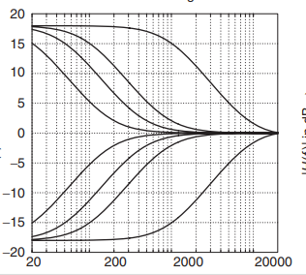
Low Shelving filter

Slide 25
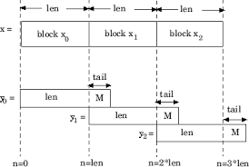
Overlap add vs ADSR

Slide 26
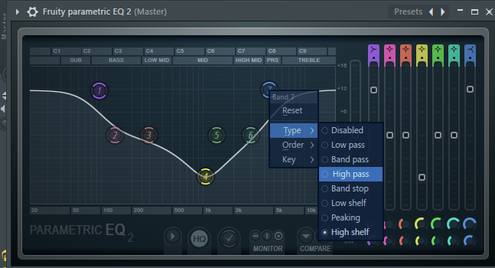
Possible improvements

